Slide 1
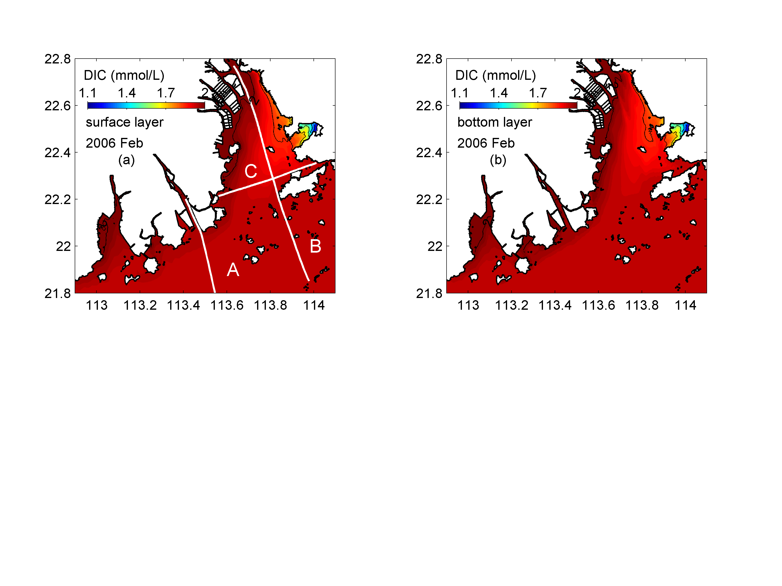
Notes:
Figure 7 Horizontal distribution of DIC in February 2006 winter. The left panels show the simulation results for the surface layer, while the right panels show the results for the bottom layers.

Slide 2
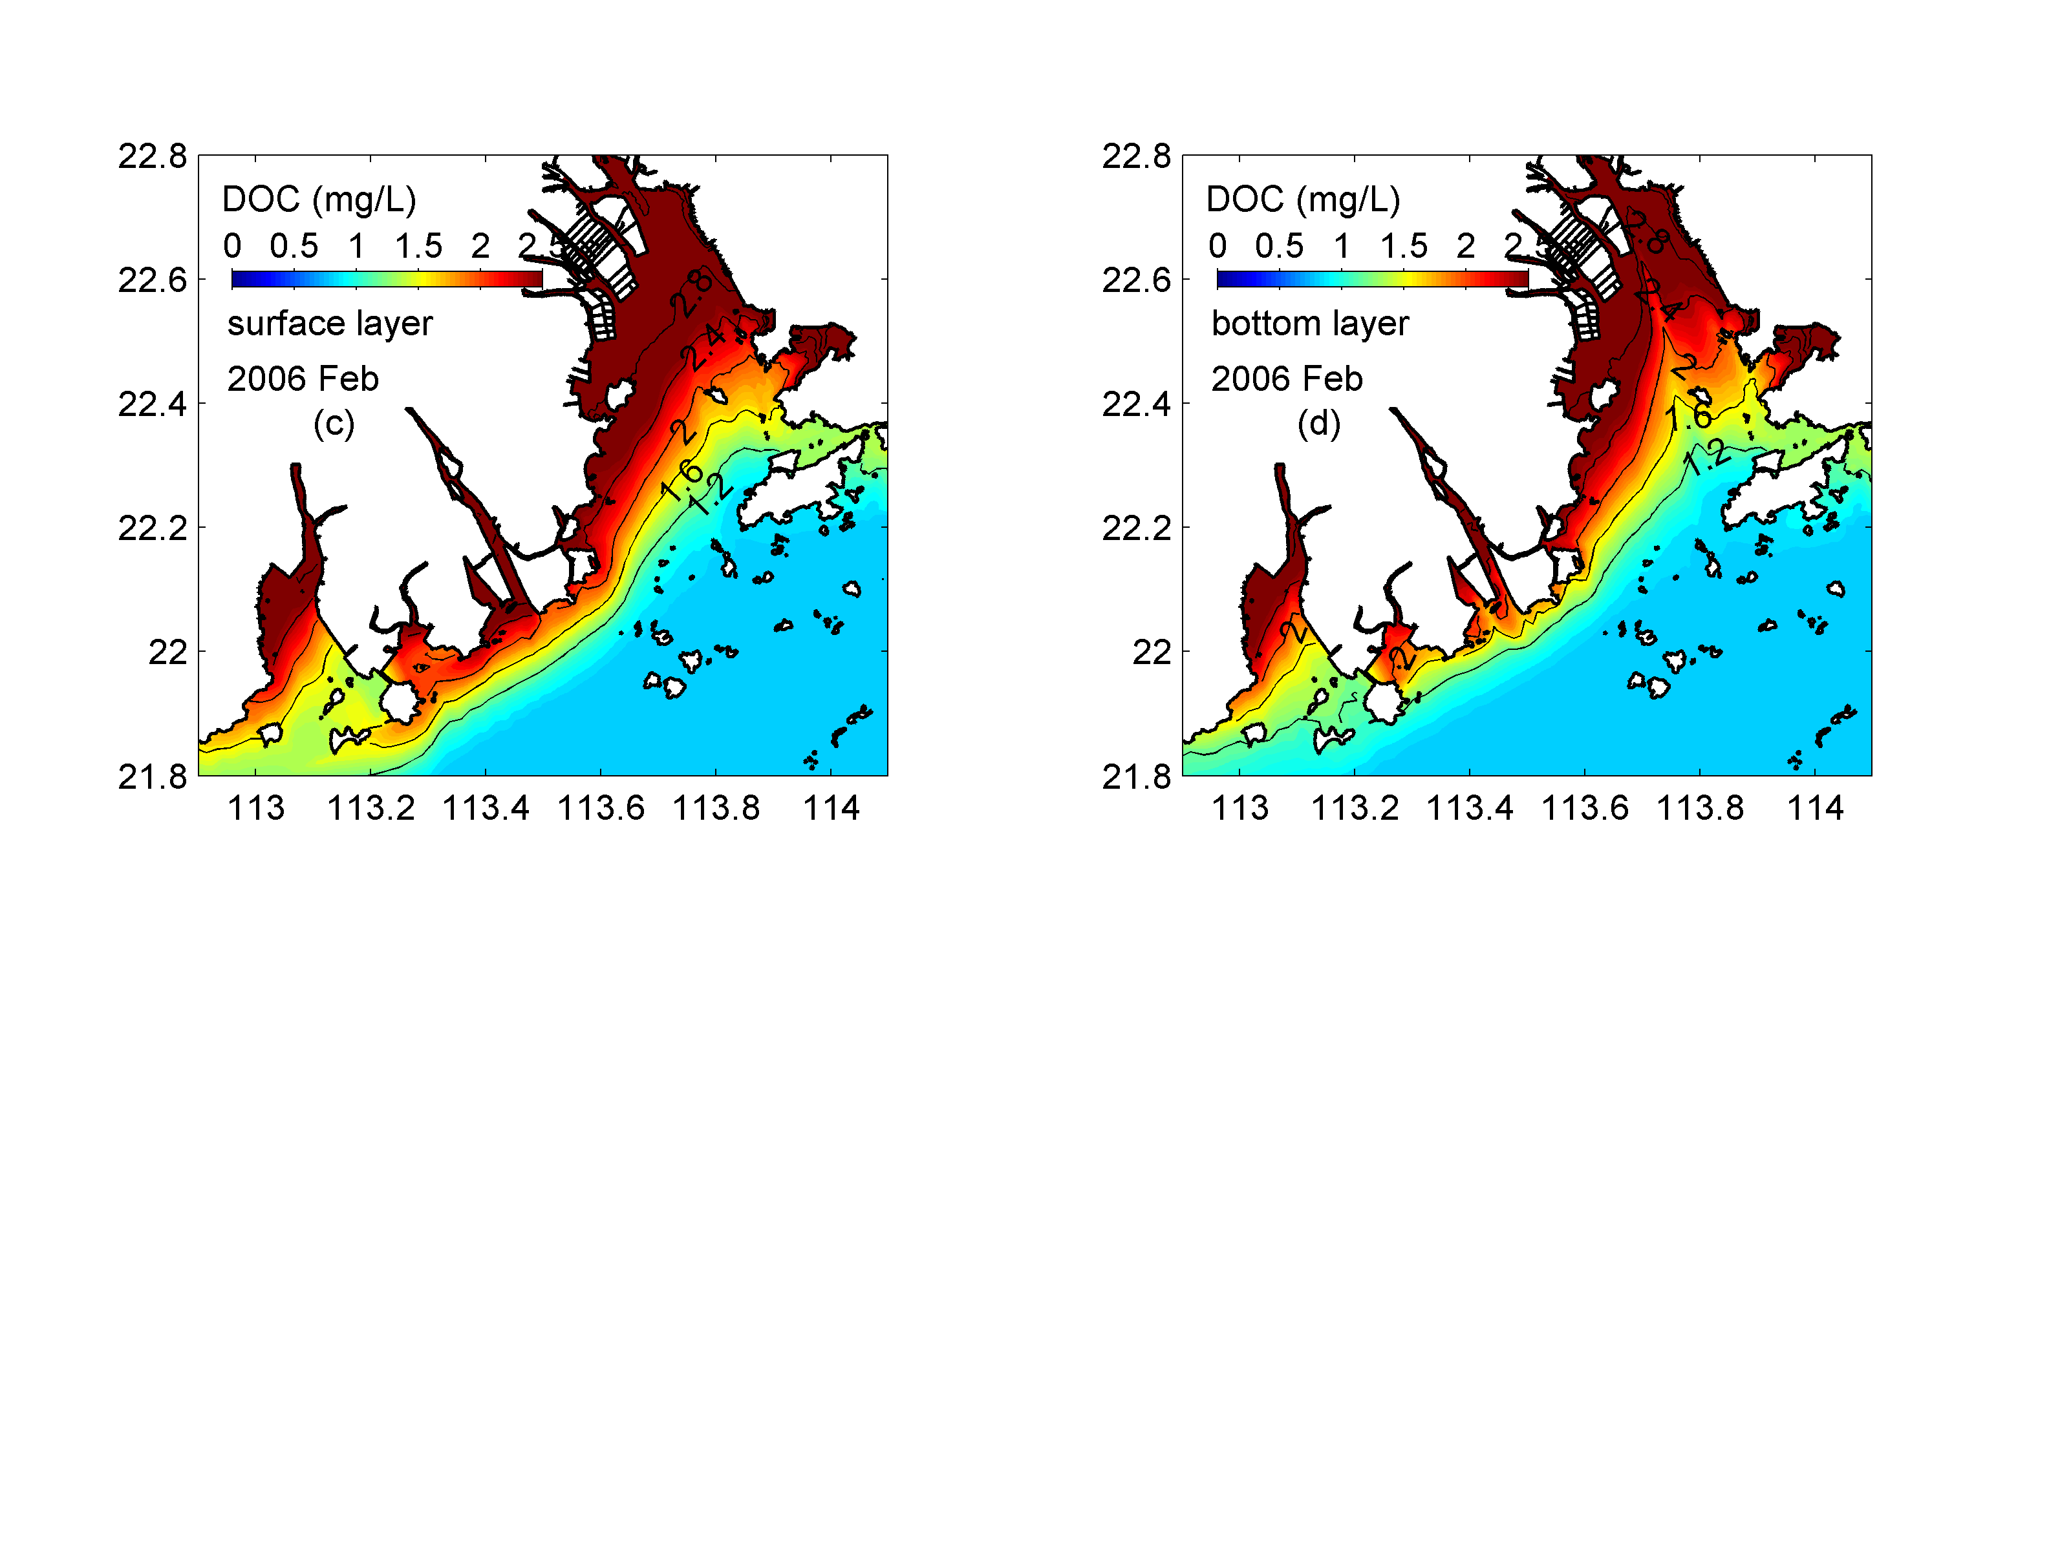
Notes:
Figure 7 Horizontal distribution of DOC in February 2006 winter. The left panels show the simulation results for the surface layer, while the right panels show the results for the bottom layers.

Slide 3
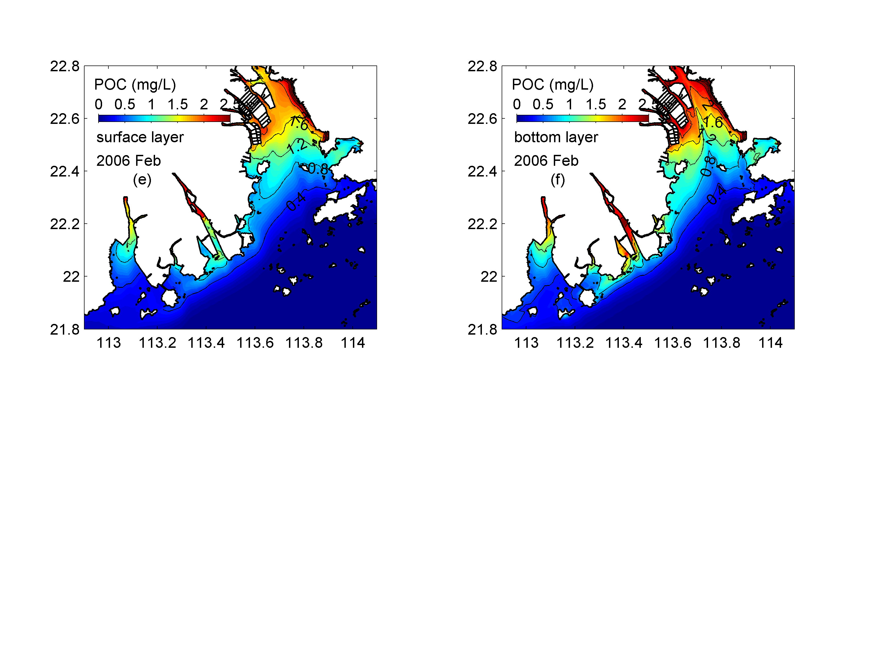
Notes:
Figure 7 Horizontal distribution of POC in February 2006 winter. The left panels show the simulation results for the surface layer, while the right panels show the results for the bottom layers.

Slide 4
Notes:
Figure 7 Horizontal distribution of DIC (upper panels), DOC (middle panels) and POC (lower panels) in February 2006 winter. The left panels show the simulation results for the surface layer, while the right panels show the results for the bottom layers.

